Slide 1
WORLD POPULATION ANALYSIS
-NIKHITHA J GADAD

Slide 2
DATASET OVERVIEW
The dataset consists of three tables. Two of these tables share the same column structure: Table 1 covers data from 2000 to 2049, while Table 2 focuses on the period from 2050 to 2100. Both Table 1 and Table 2 provide details on the male and female population by age group and the countries they belong to. Table 3 contains information about countries, including their corresponding continent, region codes, and country codes.

Slide 3
TOOLS USED
Microsoft Power BI, Power Query & DAX

Slide 4
DATA CLEANING
The data types for columns with incorrect formats were corrected. Column names were updated to more appropriate labels. The "Age Group" column contained some rows with months alongside age groups, which were replaced with numerical values. The population columns for men and women were multiplied by 1000 and rounded. Unnecessary columns were removed, and the men and women population columns were pivoted. Finally, the two tables were combined (appended)

Slide 5
DATA MODELLING
After completing the cleaning and transformation process, I closed and loaded the dataset into the model. I then established relationships between the three tables using a one-to-many relationship, with FactPopulation serving as the fact table and DimRegion and DimAge as the dimensional tables.

Slide 6
DATA ANALYSIS
I analyzed the data and developed several DAX measures to enhance my analysis.
These measures include the total number of countries, the average population, and the running total of the population.
Using these measures, I created a report with charts and slicers to visualize the data

Slide 7
FINDINGS

Slide 8
Population = 943 billion
Number of countries = 194

Slide 9
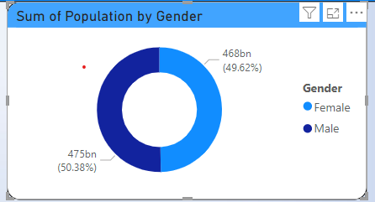
What is the composition of the male and female populations worldwide?
The male and female populations are nearly evenly distributed worldwide, with only minor differences

Slide 10
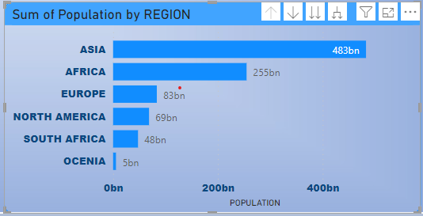
Which region is highly populated?
Asia has the largest population among all regions, followed by Africa in second place, while Oceania has the smallest population

Slide 11
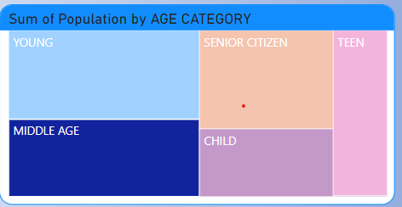
Which age group category has the highest population?
Largest Groups: The young and senior citizen categories are the most populated, each representing 25% of the total population.
Smallest Group: Teenagers form the smallest segment, comprising just 7% of the population.
Middle and Children: Together, these two groups account for 37% of the population, highlighting a substantial portion in both early life and working age.
Overall, the population distribution across categories is fairly balanced, with no group significantly outweighing the others.

Slide 12
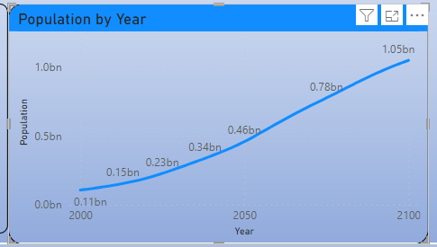
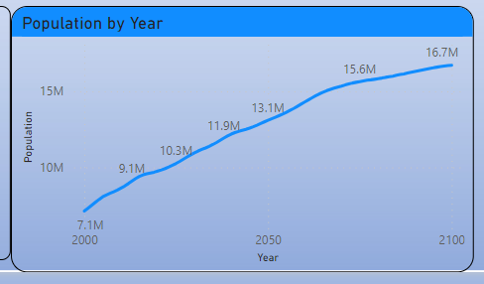
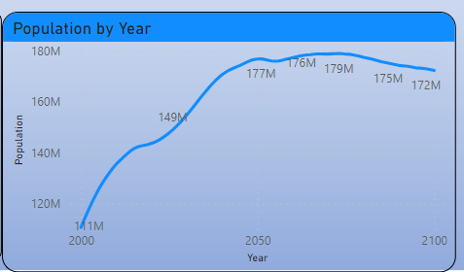
What are the population trends across all regions over the years??
Africa, Oceania, and North America exhibit a consistent upward trend in population growth over time. Starting from relatively low levels, the population steadily increases, reaching much higher levels by the end of the timeline.
Africa
Oceania
North America

Slide 13
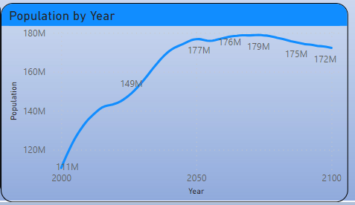
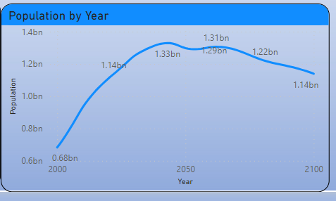
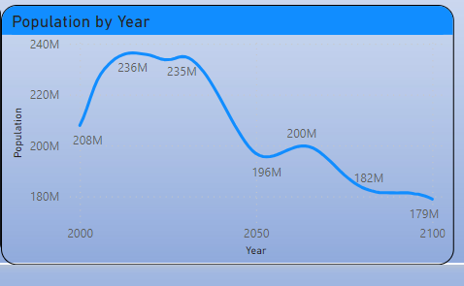
South America and Asia exhibit a population trend that rises steadily initially, peaking in the middle of the timeline. Following the peak, the population starts to gradually decrease as the period progresses toward the end.
Europe exhibits a population trend that begins with a gradual increase, reaching its peak early in the timeline. After the peak, the population steadily declines, with the decrease becoming more pronounced over time.
South America
Asia
Europe

Slide 14
RECOMMENDATIONS

Slide 15
To slow population growth in Asia, key strategies involve improving access to family planning, education (particularly for women), and healthcare to reduce infant mortality. Encouraging urbanization, economic development, and social security can also contribute to lower birth rates. Governments could incentivize smaller families and support later marriage and childbearing. Furthermore, promoting gender equality and offering workplace support for parents can encourage smaller families, helping to balance population control with an enhanced quality of life.

Slide 16
To increase population in Europe, key strategies include –
Offering financial incentives for families, improving paid parental leave, and providing affordable childcare and housing.
Policies to attract immigrants and support their integration, along with flexible work arrangements, can help boost population.
Encouraging work-life balance, promoting gender equality, and providing fertility treatments are also important. Additionally, improving access to healthcare and education on reproductive health, as well as creating job opportunities for young people, can encourage early family planning and support family growth.
There is no need to focus on increasing the population in Oceania, Africa and North America as it has experienced steady population growth over the years.

Slide 17
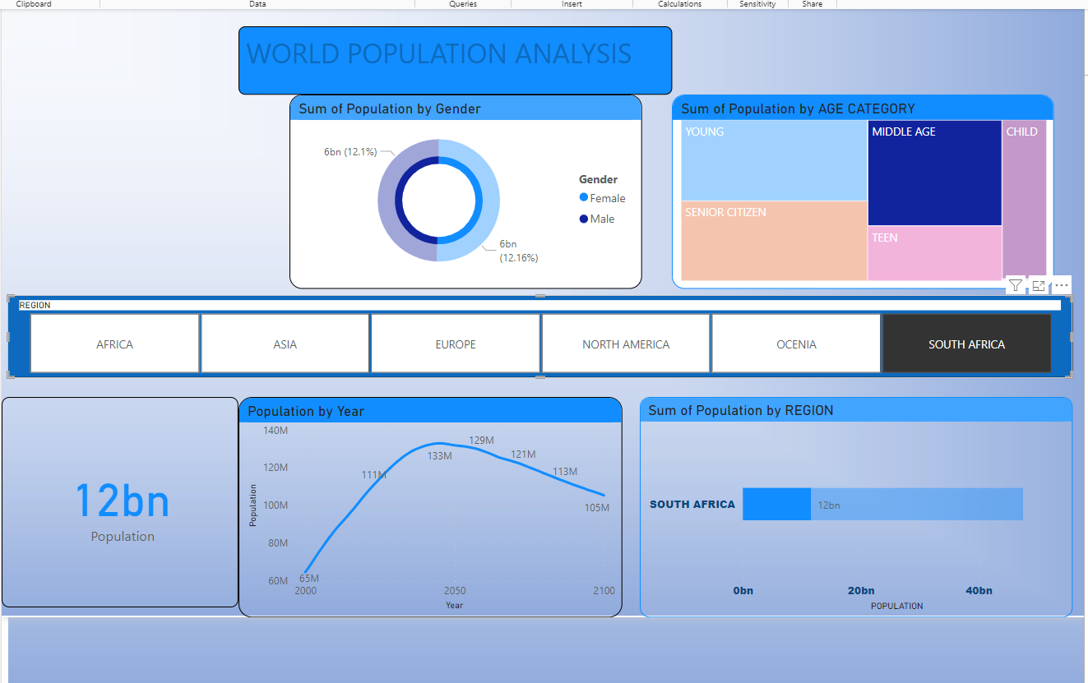

Slide 18
THANK YOU

